Slide 1

Qubit control using reinforcement learning
Gabriele Borroni, UniMI, a.a. 2024/2025

Slide 2
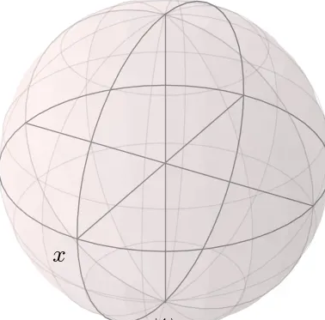




Qubits
$$\left|0\right\rangle$$
2-levels quantum systems:
$$ψ=α\left|0\right\rangle +β\left|1\right\rangle$$
Most effective representation is the Bloch-sphere:
$$ψ=\cos\left(\frac{θ}{2}\right)\left|0\right\rangle +e^{iφ}\sin{\frac{θ}{2} }\left|1\right\rangle$$
$$\left(sinθ\cos{φ},sinθsinφ,cosθ\right)$$
$$y$$
$$\left|1\right\rangle$$

Slide 3
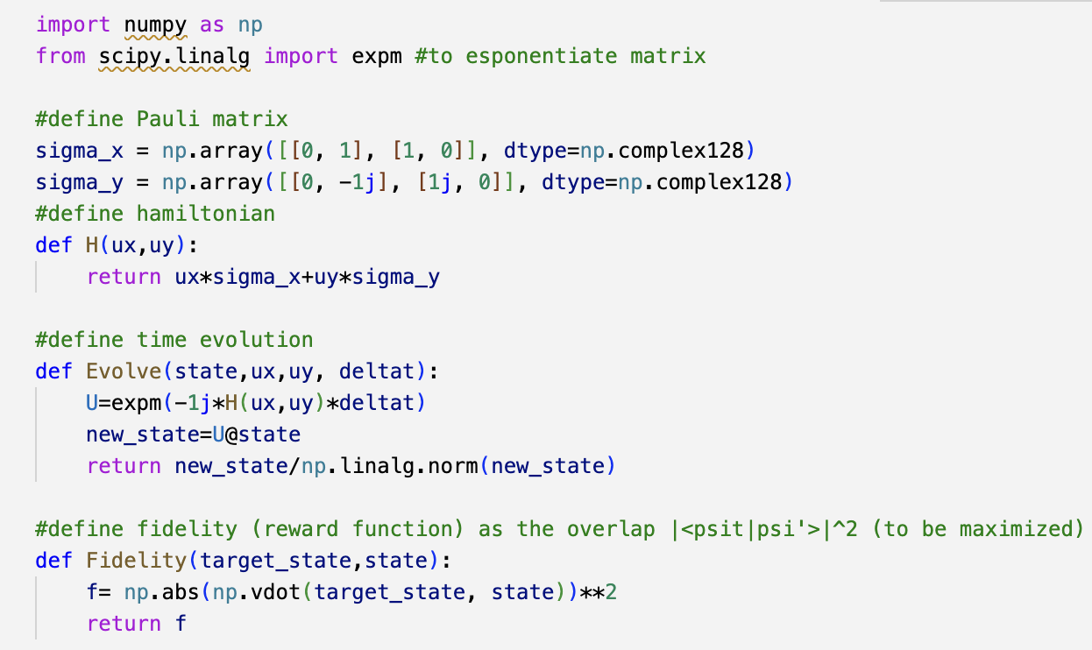

Spin Qubits
Physical realizations of Qubit using an electron spin confined in a magnetic field: $ψ=α\left|↑\right\rangle +β\left|↓\right\rangle$
The Hamiltonian can be modeled as $H(t)=u_{x}(t)σ_{x}+u_{y}(t)σ_{y}$
Where $U=\left(u_{x},u_{y}\right)$ parametrizes the action of an extern E.M. field
Time evolution:
$$ψ\left(t+Δt\right)=e^{−iH\left(t\right)Δt}\left|ψ\left(t\right)\right\rangle$$

Slide 4







Reinforcement learning
Agent interacts with the environment and receives a reward based on its action.
The better the action, the greater the reward
The agent follows a policy, wich tells it the action to take in each state:
$$π\left(s_{t}\right)=a_{t}$$
The agent aims to find a policy that maximizes the expected cumulative (discounted) reward:
$$π^{∗}=\arg{\max_{π}{E}}\left[\sum_{t≥0}{γ^{t}r_{t}} | π\right]$$
Action $a_{t}$
Agent
Environment
Next state $s_{t+1}$
Reward r

Slide 5

Deep Q-Learning (DQN)
The core is the action-value function:
$Q^{π}\left(s,a\right)=E\left[\sum_{t=0}^{∞}{γ^{t}r_{t}} | s_{0}=s, a_{0}=a, π\right]$
The best policy is the one that follows the optimal Q-function:
$$Q^{∗}=\max_{π}{Q^{π}}\left(s,a\right) → π^{∗}=arg\max_{a}{Q^{∗}\left(s,a\right)}$$
It can be recursively computed using the bellman equation:
$Q^{∗}\left(s,a\right)=𝔼\left[r+γmax_{a’}\left(Q\left(s’,a’ \right)\right) | s,a\right]$
At each step, the update follows:
$Q^{i+1}\left(s,a\right)=𝔼\left[r+γmax_{a’}\left(Q^{i}\left(s’,a’\right)\right) | s,a\right]→Q^{∗}$

Slide 6



Training loop
$Q^{π}\left(s,a\right)=E\left[\sum_{t=0}^{∞}{γ^{t}r_{t}} | s_{0}=s, a_{0}=a, π\right]$
evaluates expected reward of a state-action pair, following the current policy. Here it is parametrized by a DNN.
the agent stores experiences in a replay buffer, then samples minibatches to compute target values y using a target DNN, (a copy of the agent updated periodically)
y$=r+γmax_{a’}Q\left(s’,a’;θ^{−}\right)$
The online network is trained by minimizing the MSE loss between target and predicted Q-values:
$$L\left(θ\right)=MSE\left(Q\left(s_{i},a_{i},θ\right),y_{i}\right)$$
Replay buffer
Online Q-network (agent)
Predicted Qs
Target Qs
Train agent
With MSE
Target Q-network

Slide 7
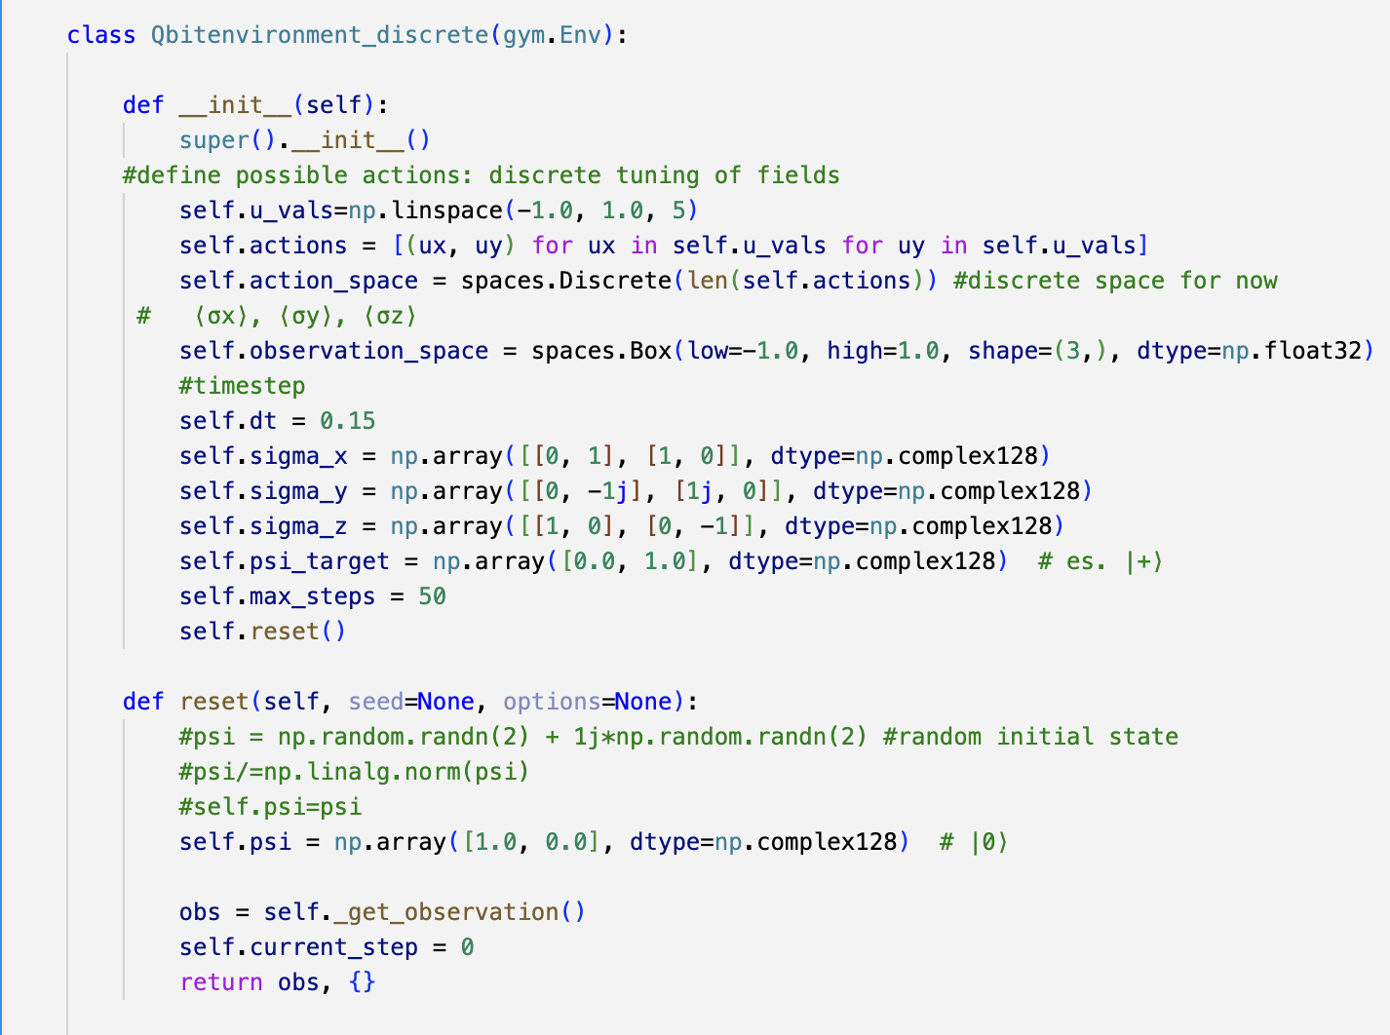
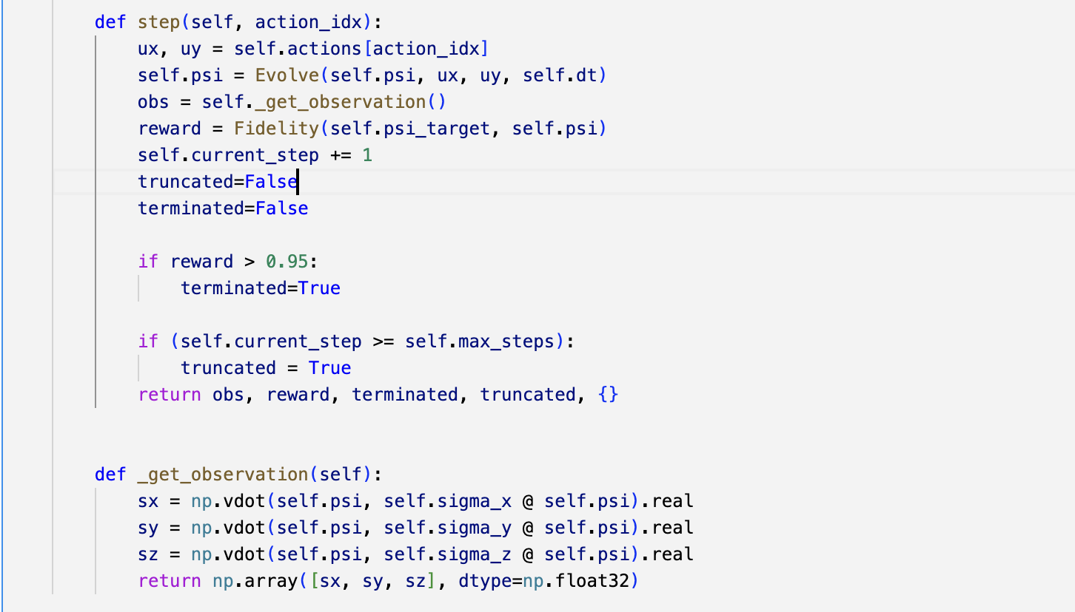
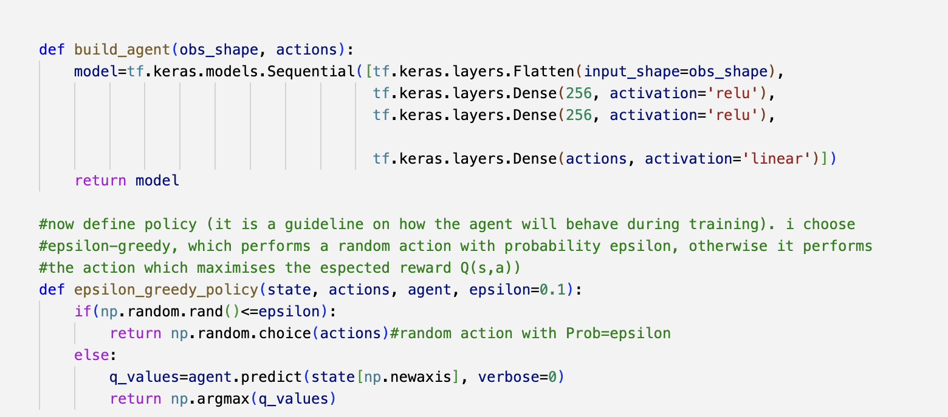
First approach: discretized action space

Slide 8
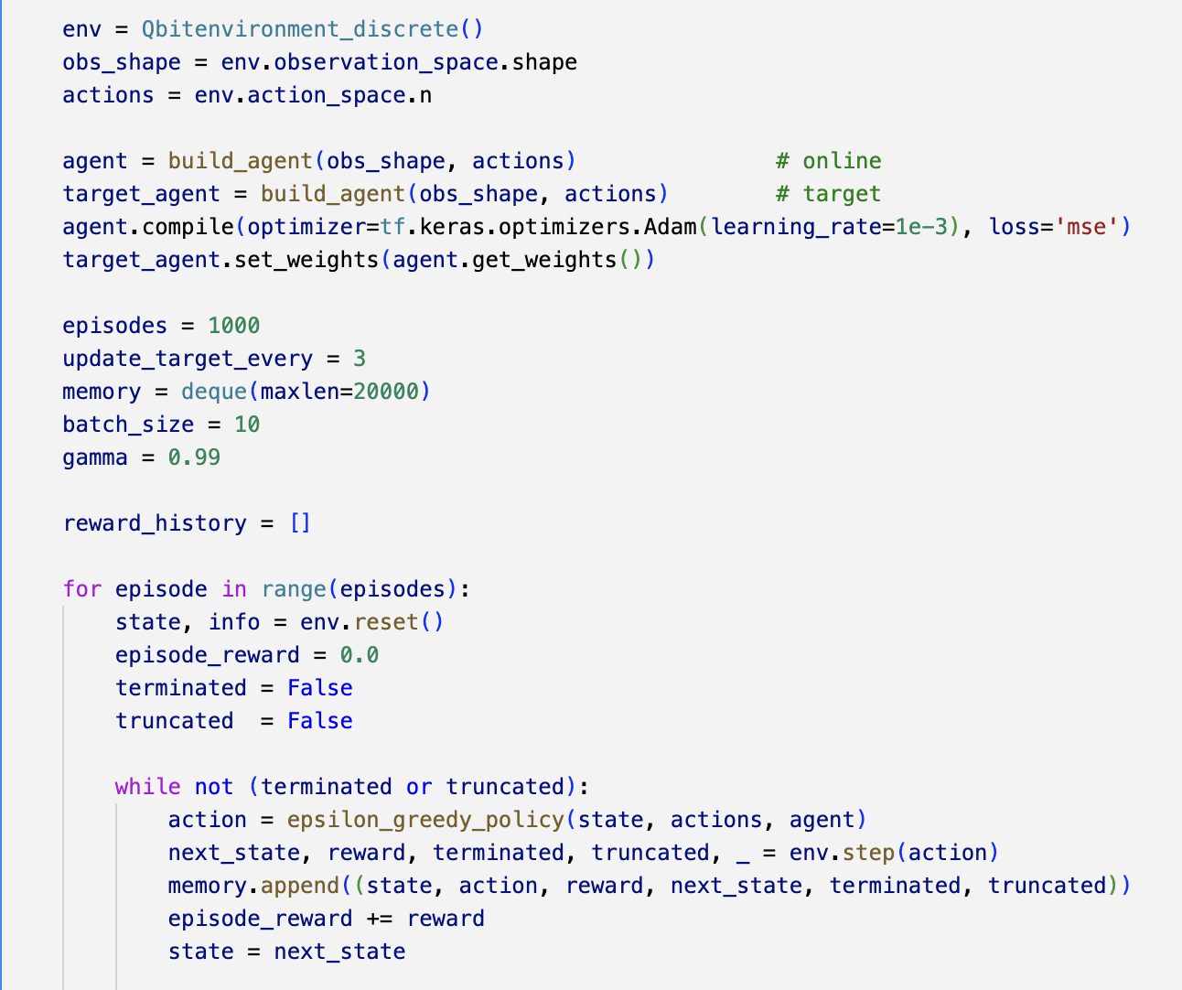
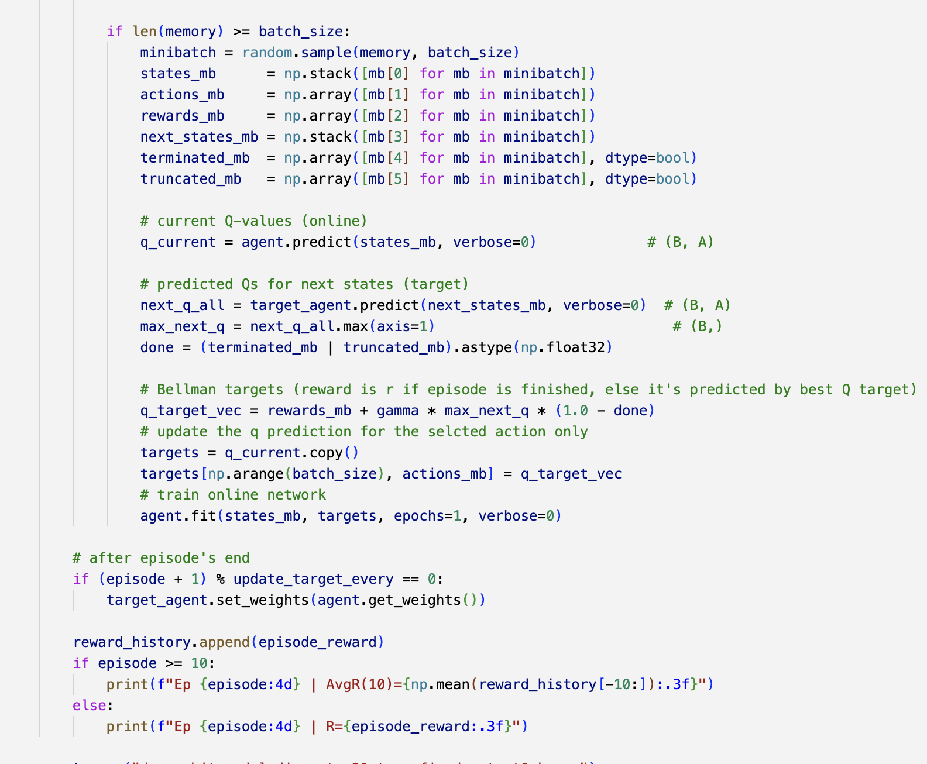
Training loop

Slide 9
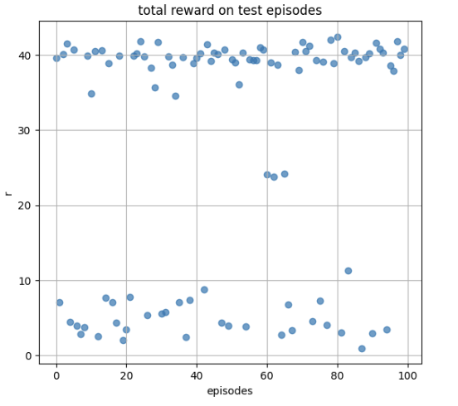
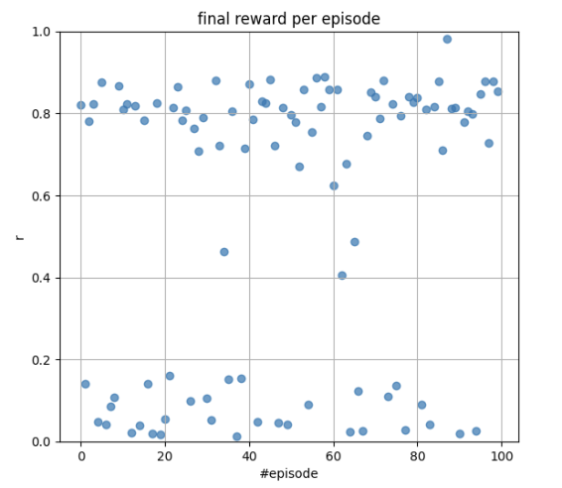
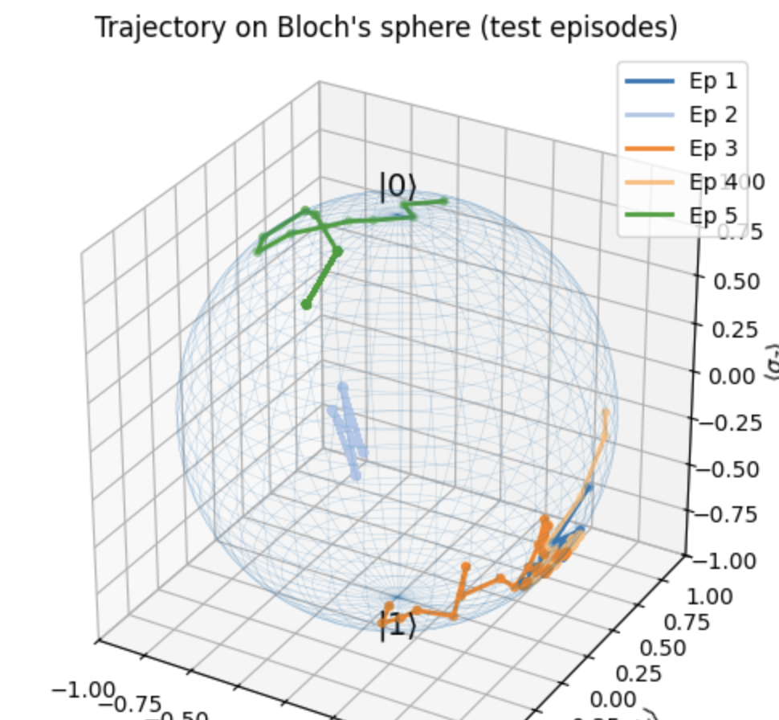
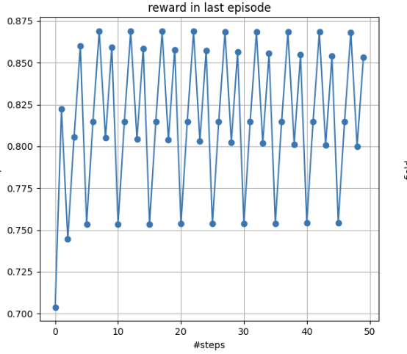
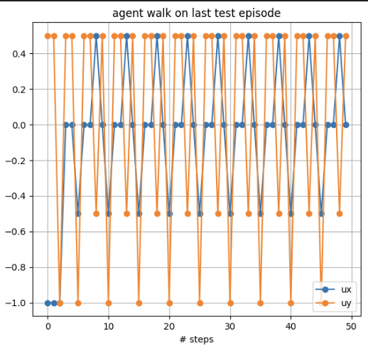
Results

Slide 10

Continuous action space- Soft Actor Critic (SAC)
Ingredients:
Advantages:
Actor learns to maximize:
$$J\left(π\right) = 𝔼\left[\sum_{t}{γ^{t}}r\left(s,t\right)−αlog\left(π\left(a | s\right)\right)\right]$$
Stochastic policy (actor): $π_{θ}$.
Actor returns the parameters of a PDF (Gaussian) from which the action is sampled
2-Q-values networks (critic)
Temperature for entropy regularization $α$
Replay buffer
Handles continuous action space efficiently thanks to the stochastic policy
Stable exploration-exploitation trade off throug entropy regularization
Reduced overestimation bias by using two Q-networks

Slide 11







Training loop
(s, r, a, s’)
Target evaluation:
$y_{i}=r+γ\left(\min\left(Q_{1}\left(s’.a’\right),Q_{2}\left(s’,a’\right)\right)−α\log{π_{θ}\left(a’ | s’\right)}\right)$
Actor loss:
$J\left(π\right)=𝔼[α\log{π}−\min{{(Q}_{1}\left(s,a\right),Q_{2}\left(s,a\right))]}$
Temperature update loss:
$T(α)= 𝔼[−α(\log\left(π\left(s | a\right)+H_{target}\right]]$
Replay buffer
s
(s, r, a, s’)
actor
Target critic
Samples from policy
Evaluate targets y
Q(s,a)
critic
Train by minimizing
Train by minimizing J
Update temperature
By minimizing T
$$MSE\left(Q_{i}(s,a),y\right)$$

Slide 12
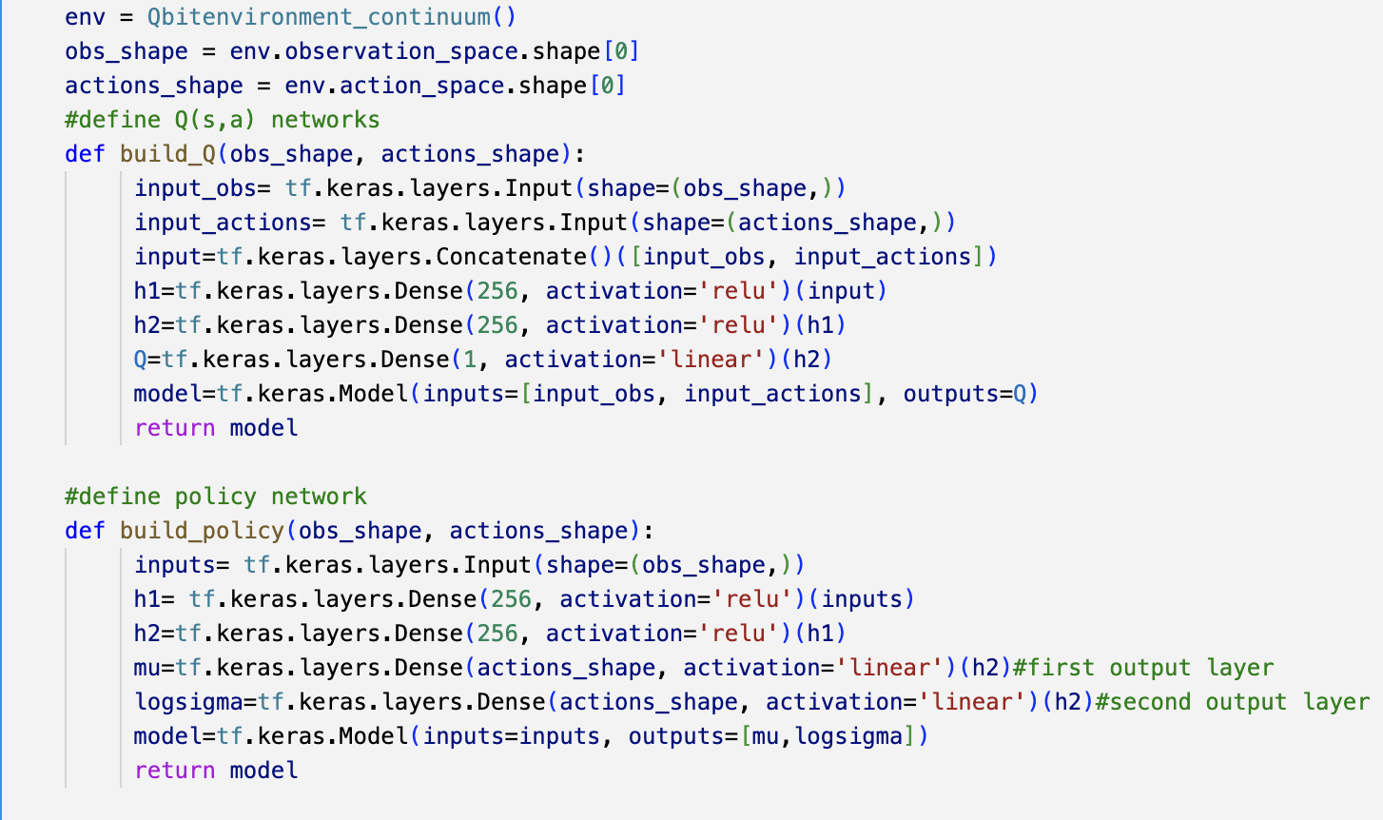
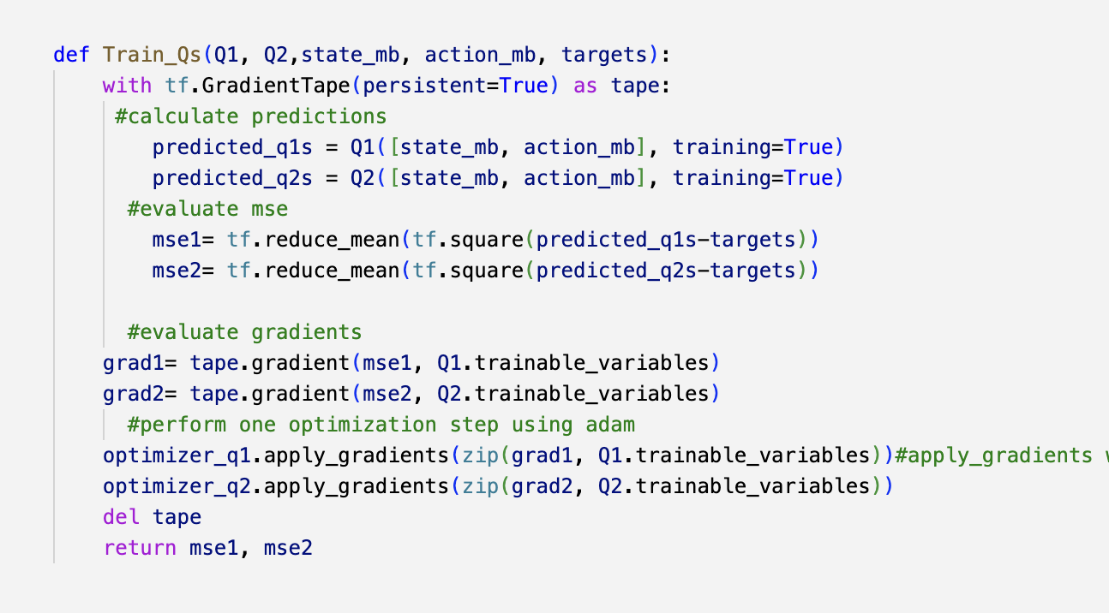
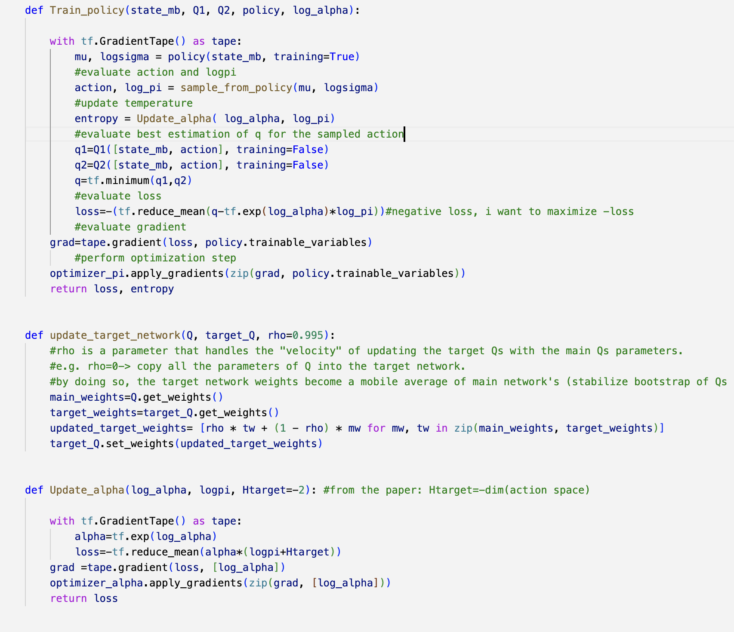
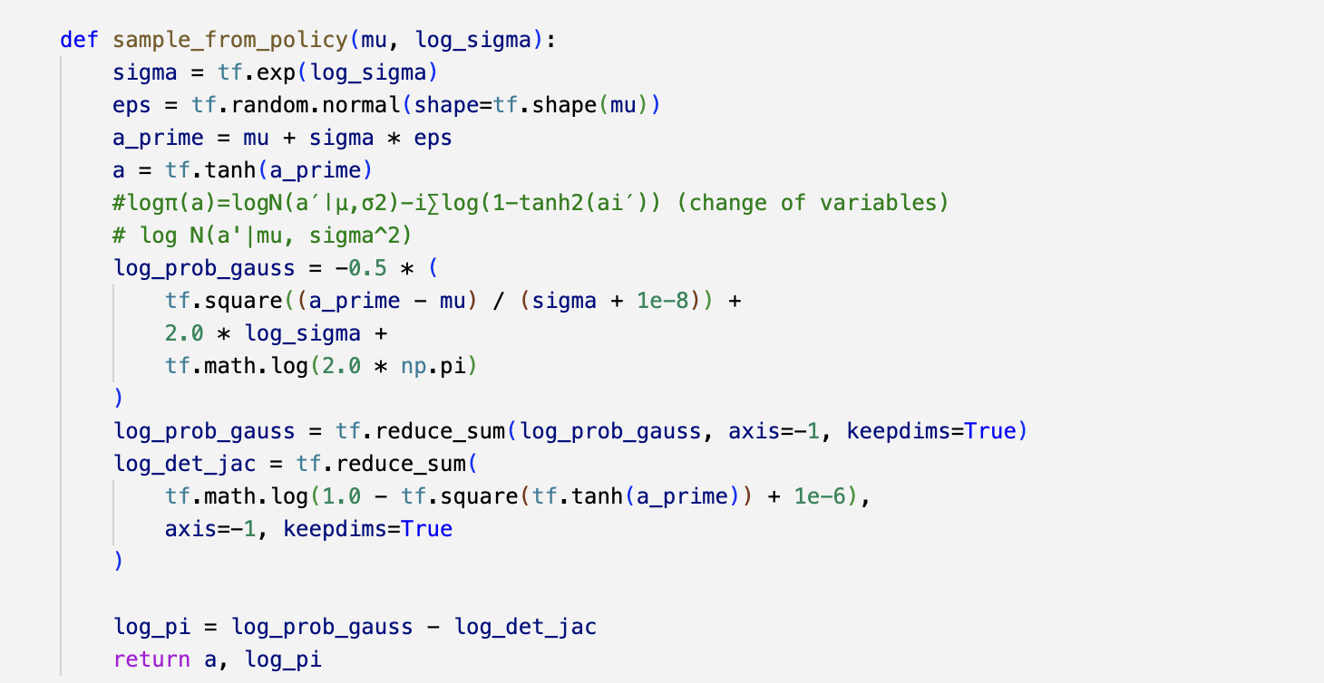

Slide 13
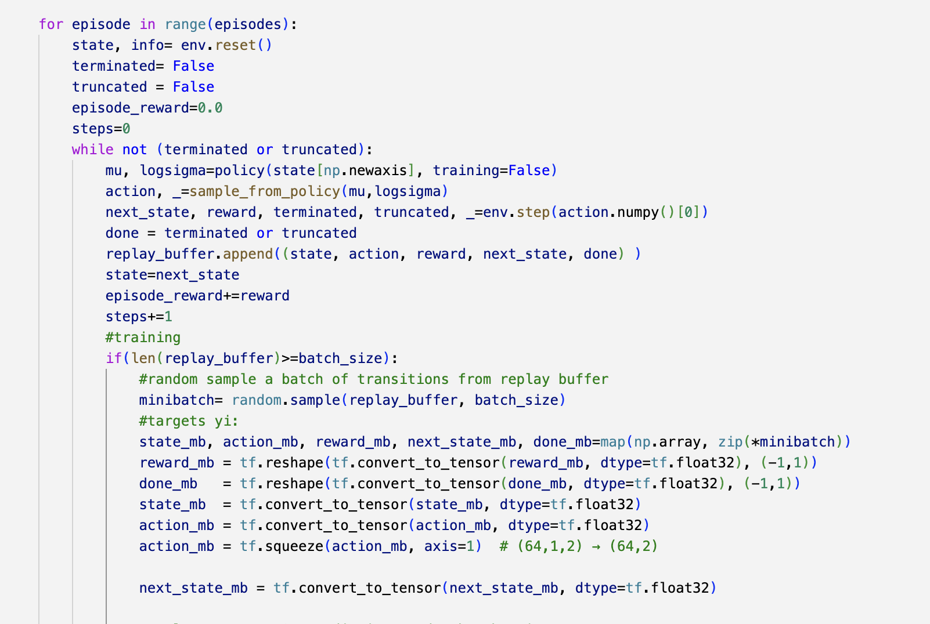
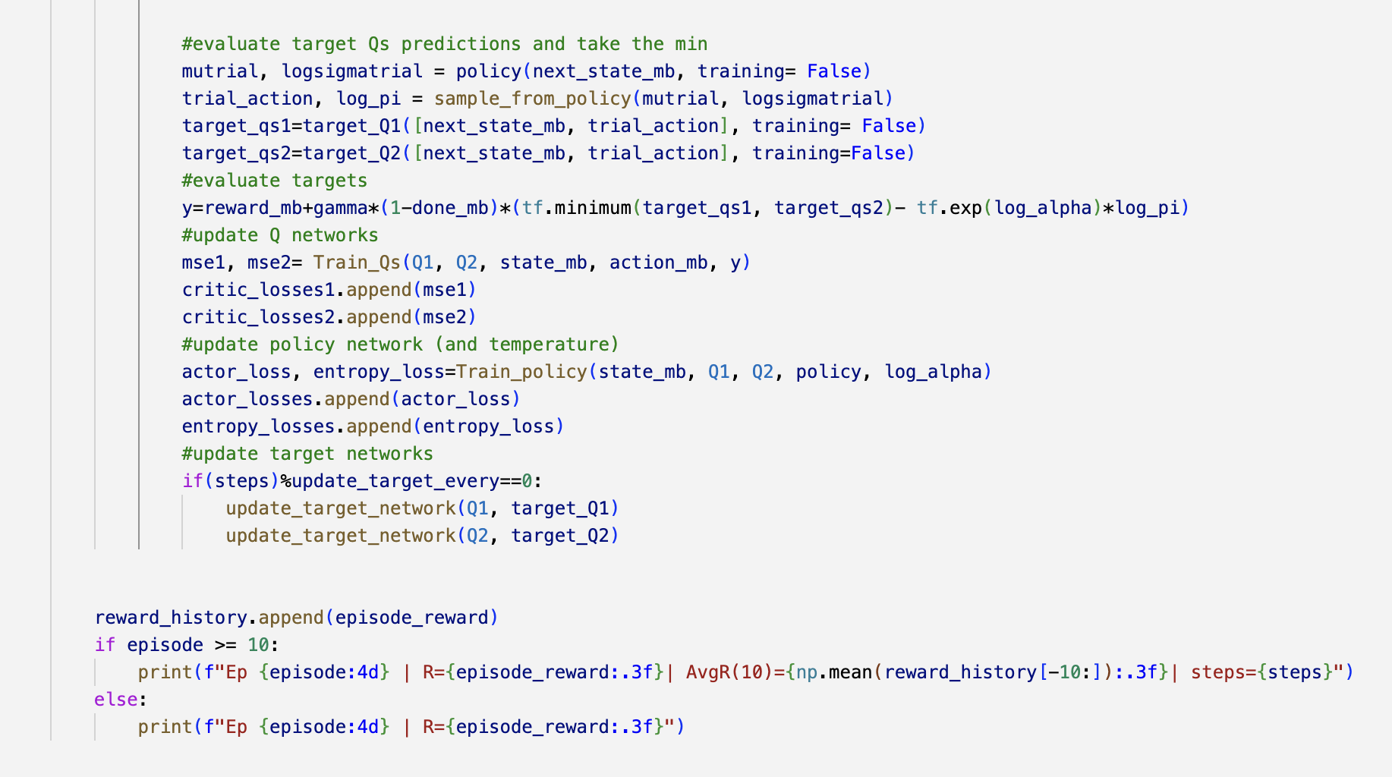
Training loop

Slide 14
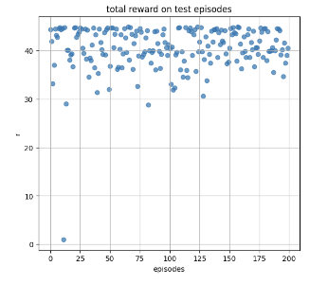
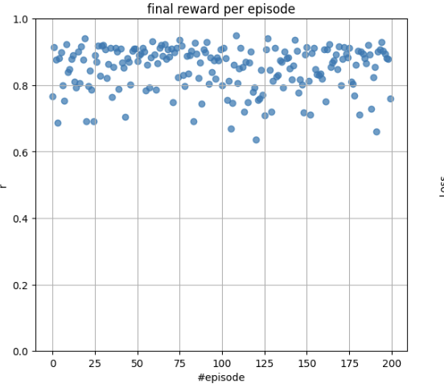
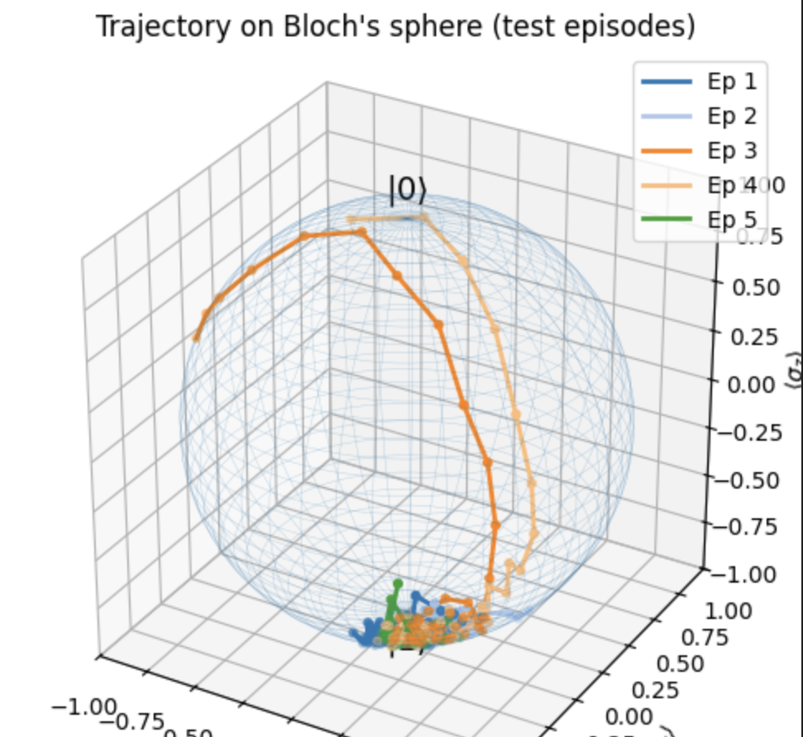
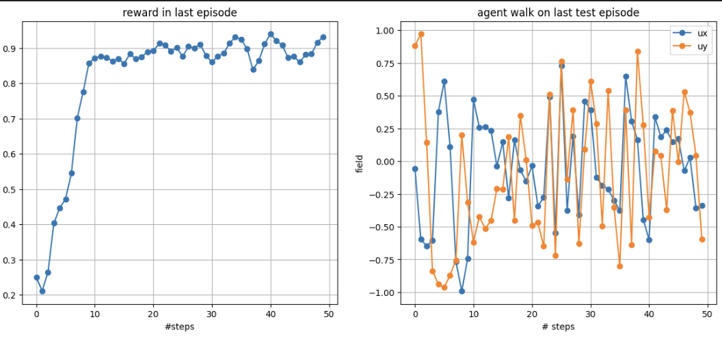
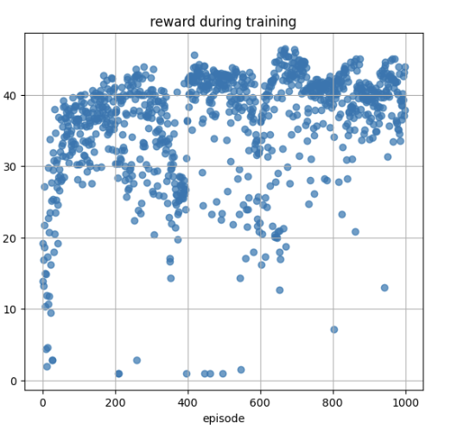
Results

Slide 15
Possible improvements
Extend the system to more than one Qbit
Extend to different Hamiltonians
Introduce noise models

Slide 16
Citations
DQN: ’’Playing Atari with deep reinforcement learning’’- DeepMind- https://arxiv.org/pdf/1312.5602
Soft Actor-Critic: Off-Policy Maximum Entropy Deep Reinforcement Learning with a Stochastic Actor- Tuomas Haarnoja, Aurick Zhou, Pieter Abbeel, Sergey Levine. https://arxiv.org/abs/1801.01290
’’Modern’’ version of the SAC algorithm by openAI: https://spinningup.openai.com/en/latest/algorithms/sac.html#soft-actor-critic
Furtherly improved version of the SAC algorithm, including automatic temperature regularization: Soft Actor-Critic Algorithms and Applications- T.Haarnoja et al. https://arxiv.org/abs/1801.01290
Gymnasium custom environments: https://gymnasium.farama.org/introduction/create_custom_env/

